Slide 1
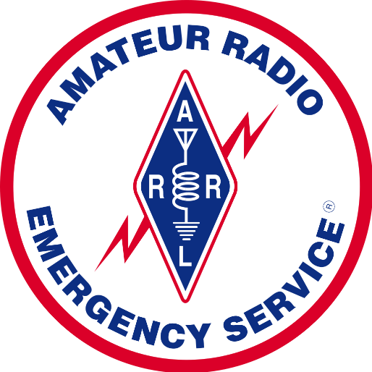
Operation Stable Mercury 2018
2018
Clint Miller KCØJUO
Story County ARES
Paul Cowley, WØYR
District 1 ARES

Slide 2
2018
Iowa ArMY NATIONAL GUARD
STATEWIDE COMMUNICATIONS EXERCISE
April 23-24, 2018

Slide 3
Join us for the Iowa National Guard’s Operation Stable Mercury - 2018
Iowa’s Premier Statewide Communications Exercise remembers the devastating storm event of June 29, 1998.
Practicing statewide communications is a great way to prepare for future events.
Join other Storm Spotters, Amateur Radio Emergency Services operators, Military Amateur Radio Service operators, Public Safety First Responders, Emergency Management professionals, and Soldiers and Airmen.
Spend 15 minutes to issue a report to the National Weather Service or two days providing emergency communications across the state.

Slide 4
20th Anniversary
IOWA Derecho
COMMEX in military lingo
June 29, 1998

Slide 5
Iowa National Guard’s Operation Stable Mercury - 2018
Website with exercise weather radar feed using real events from 1998.
Use DMR and SKYWARN networks to communicate with NWS.
ARES and MARS activities supporting Incident Commanders in Cedar Rapids, Iowa City, and Des Moines on HF, VHF, and UHF.
Statewide HF net using NIFOG 60m interoperability frequencies for voice and data traffic.
Meet and network with others before disaster strikes.

Slide 6
Iowa National Guard’s Operation Stable Mercury - 2018
Sign up now!
https://goo.gl/forms/OGjAHhSjEgZEMGve2
Look for an email from W0YR to the All Counties list

Slide 7
Iowa National Guard Communication Exercises History
COMMEX in military lingo
Iowa National Guard 671st Troop Command
Colonel Robert Hedgepeth (RET)
Iowa Statewide Interoperable Communications Systems Board (ISICS)

Slide 8
COMMEX #1
March, 2014
Iowa National Guard only
COMMEX #2
Fall 2014
Added Civilians

Slide 9
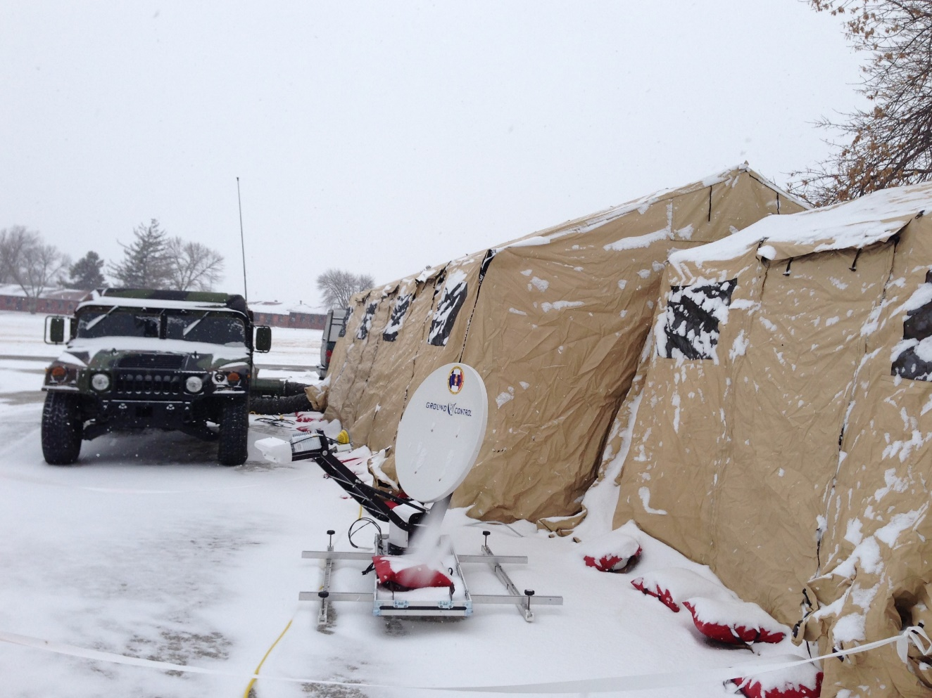

Slide 10
COMMEX #3
April 17, 2015
Camp Dodge, Johnston
Federal, State, and Local Agencies
Story ARES
COML trainee class

Slide 11
COMMEX #3
Objectives
Become familiar with other organization’s comms capabilities
Test interoperability on federal and non-federal NIFOG frequencies
Share common operating picture and real-time video data feeds
Complete COMT and COML task book tasks with evaluator sign-off

Slide 12
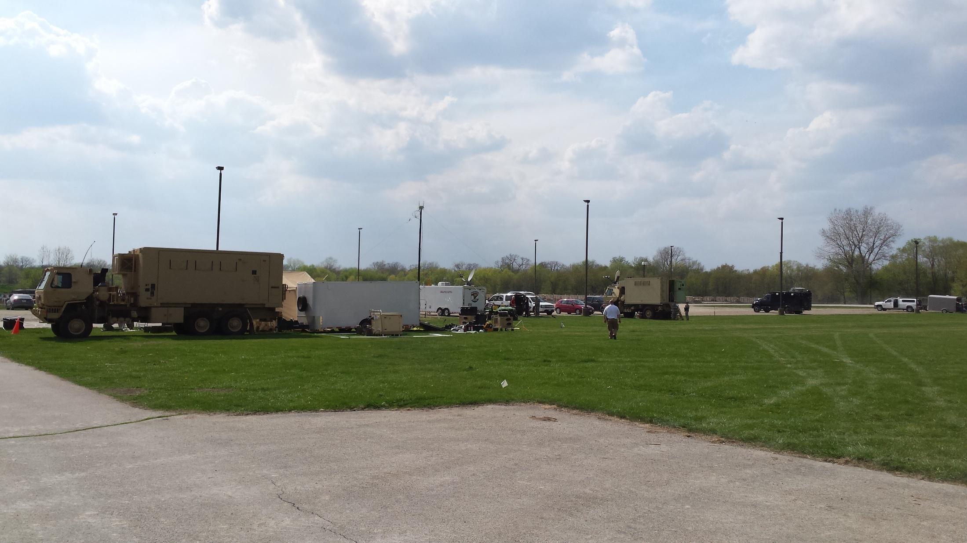

Slide 13
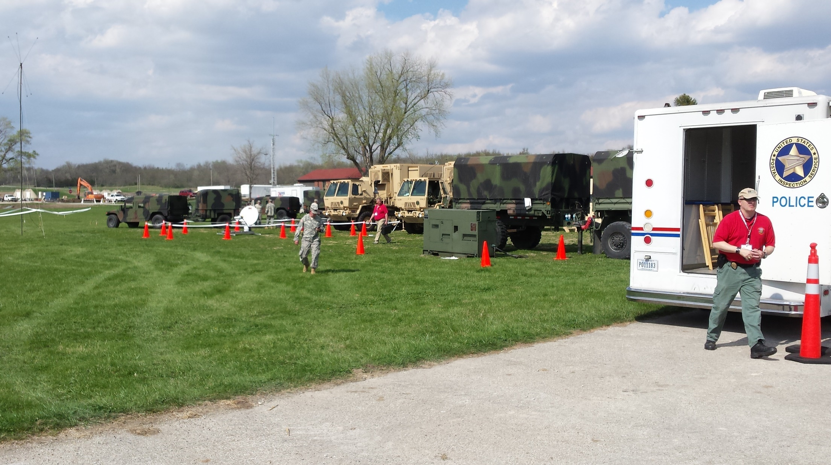

Slide 14
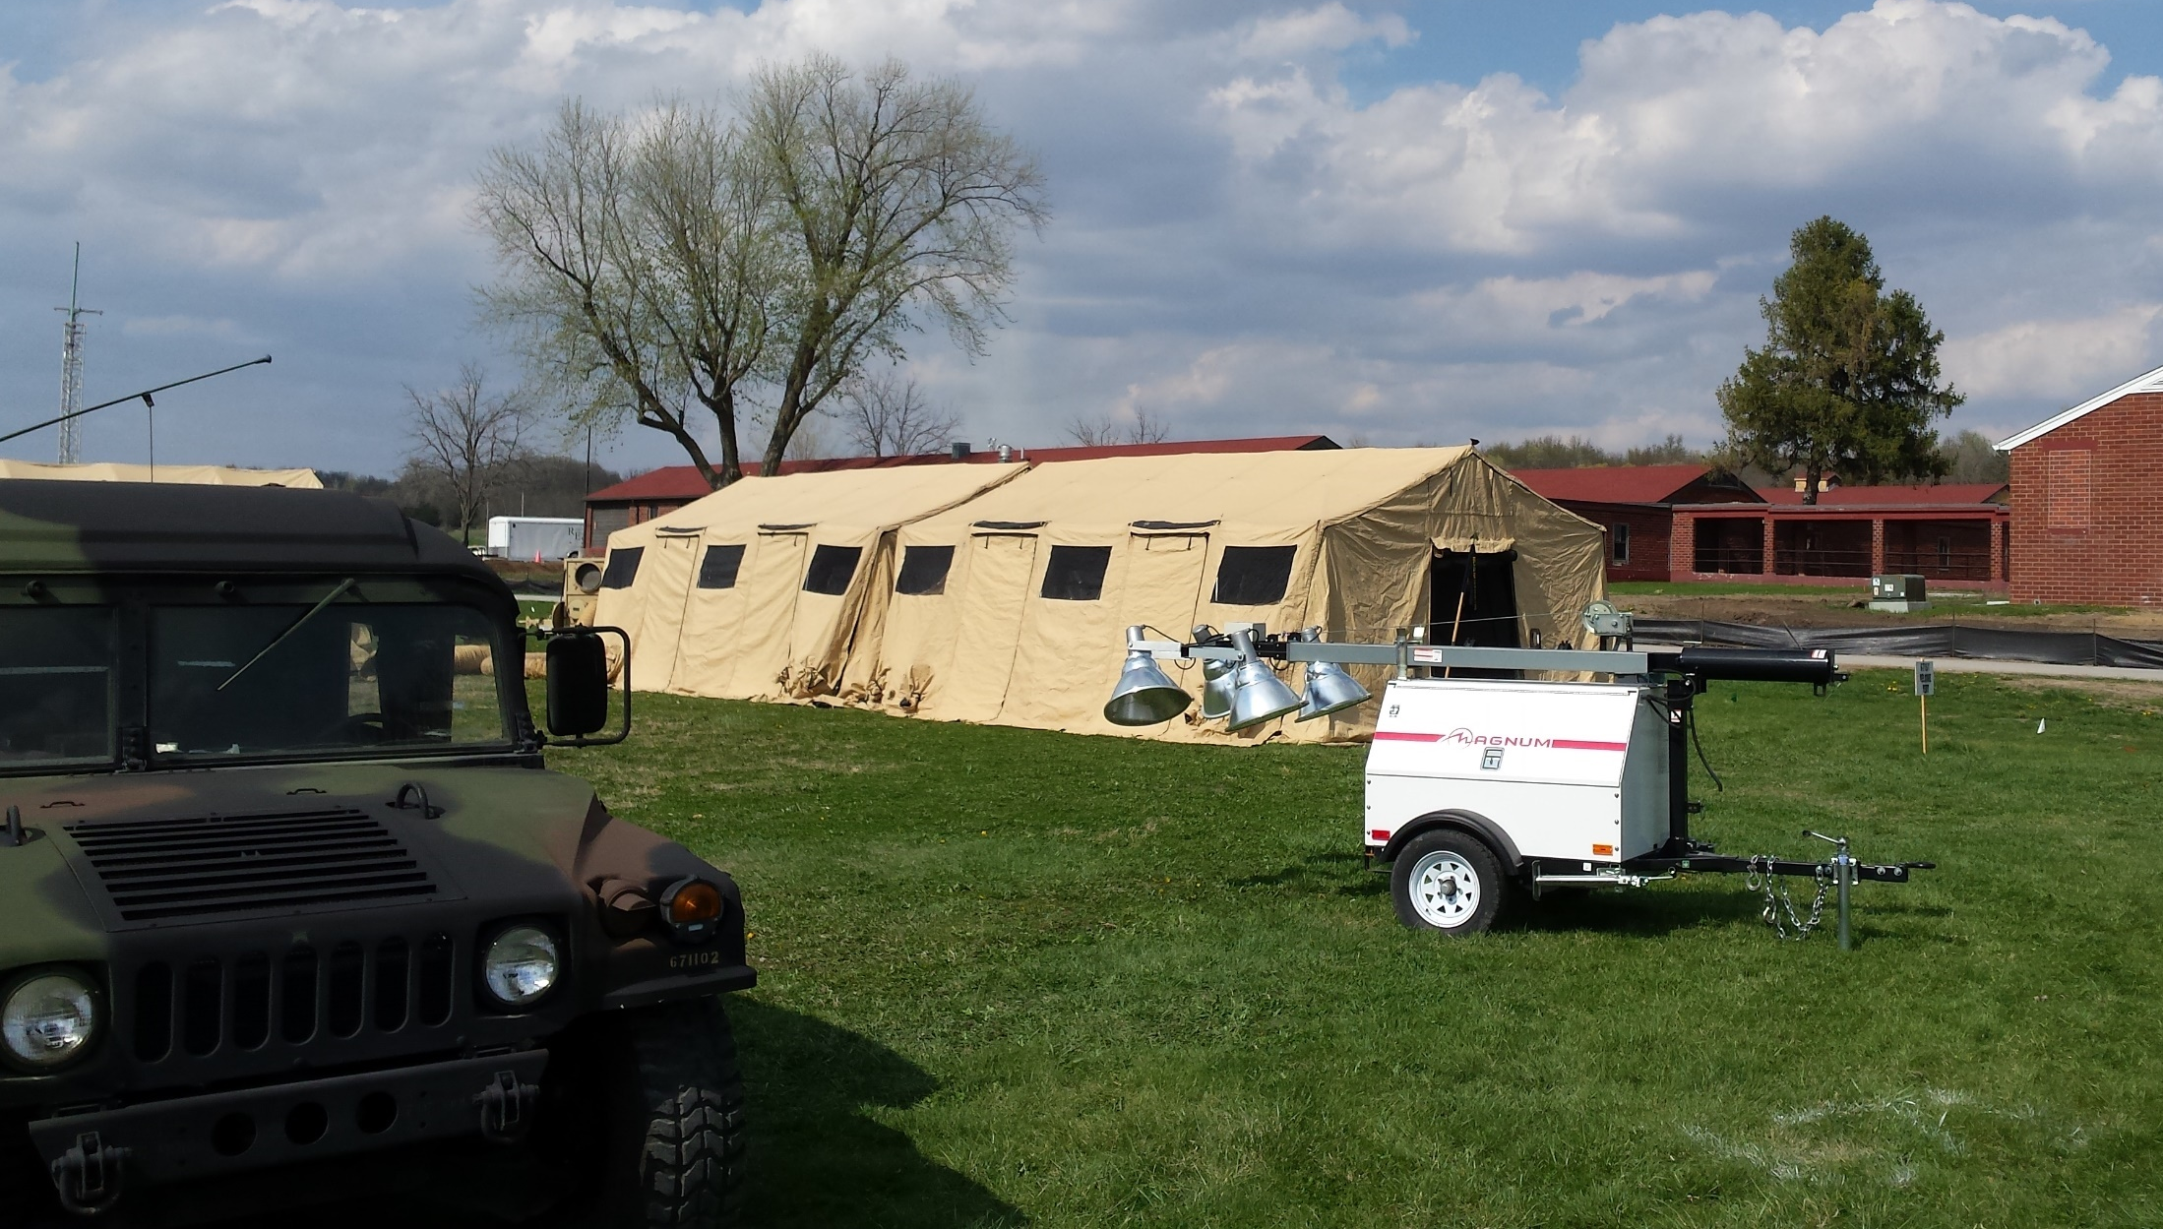

Slide 15
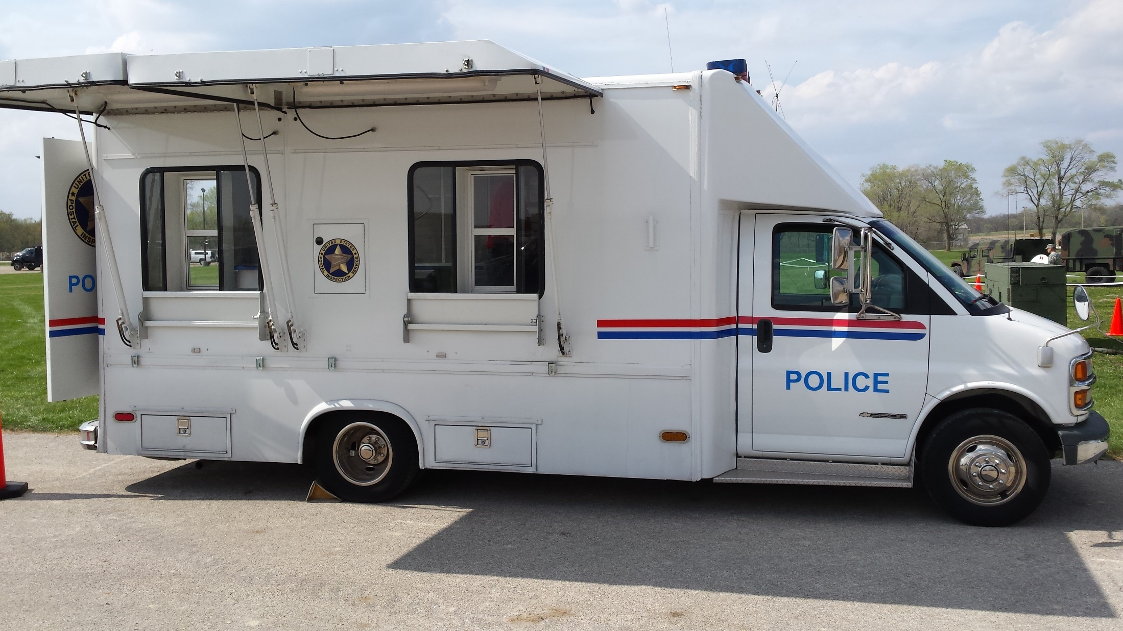

Slide 16
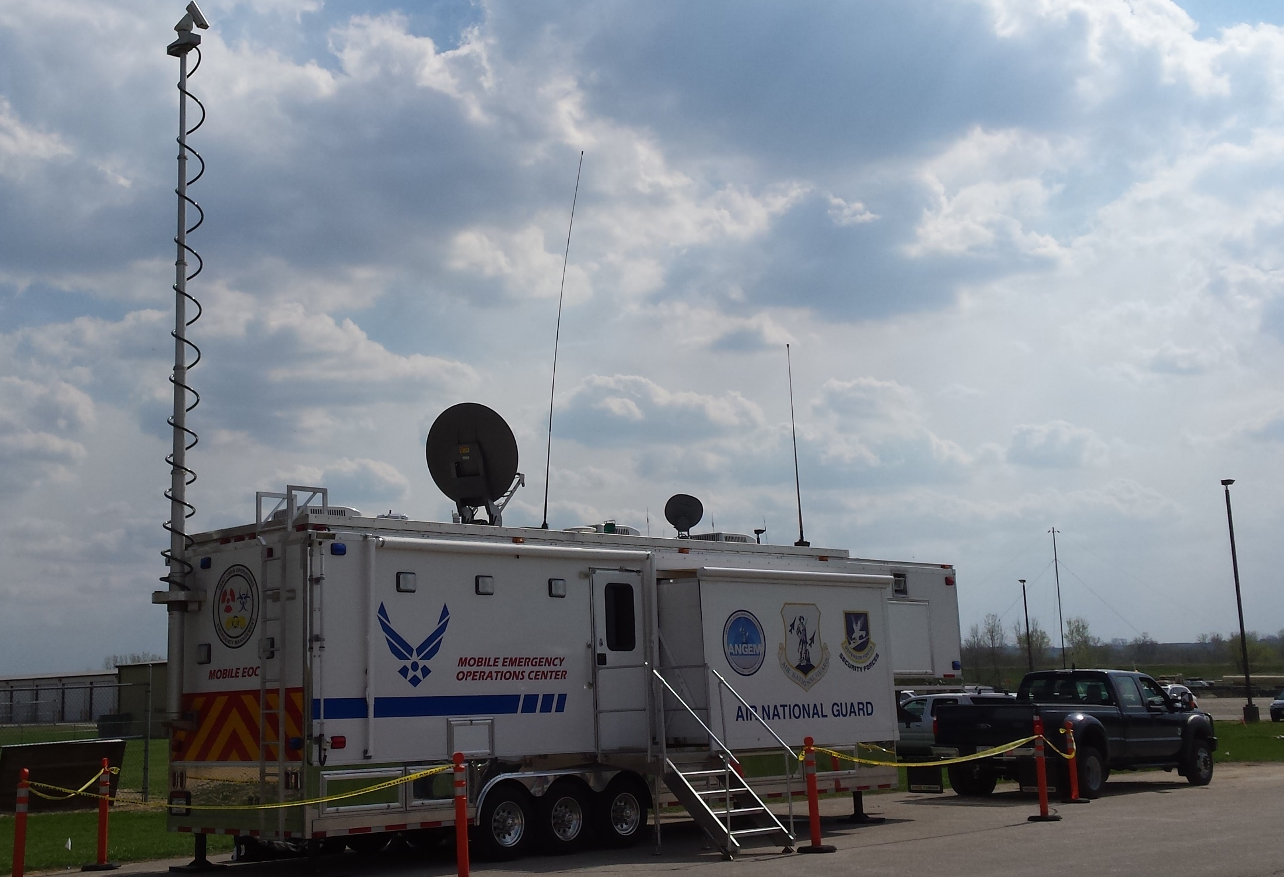

Slide 17
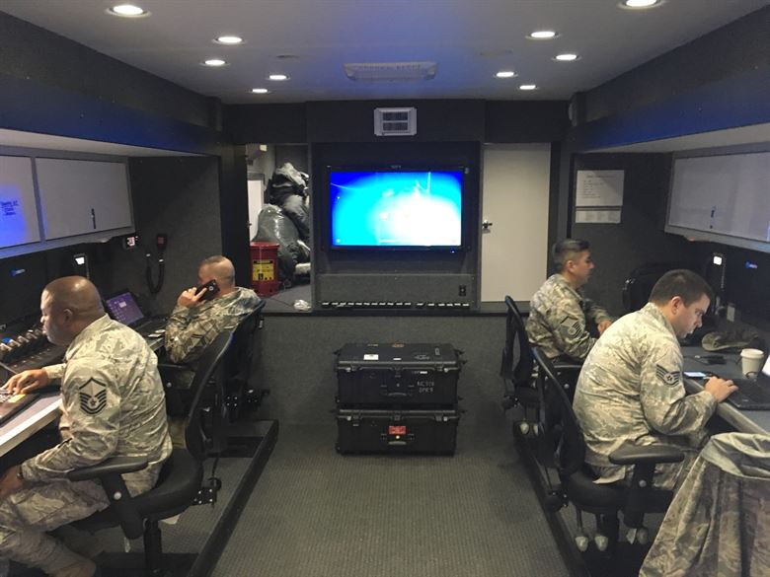

Slide 18
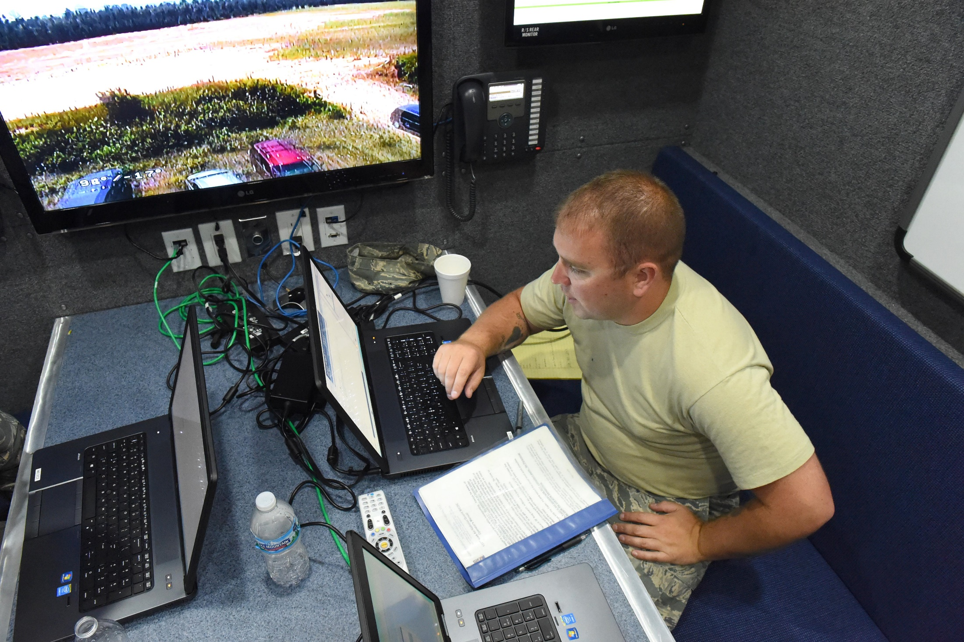

Slide 19
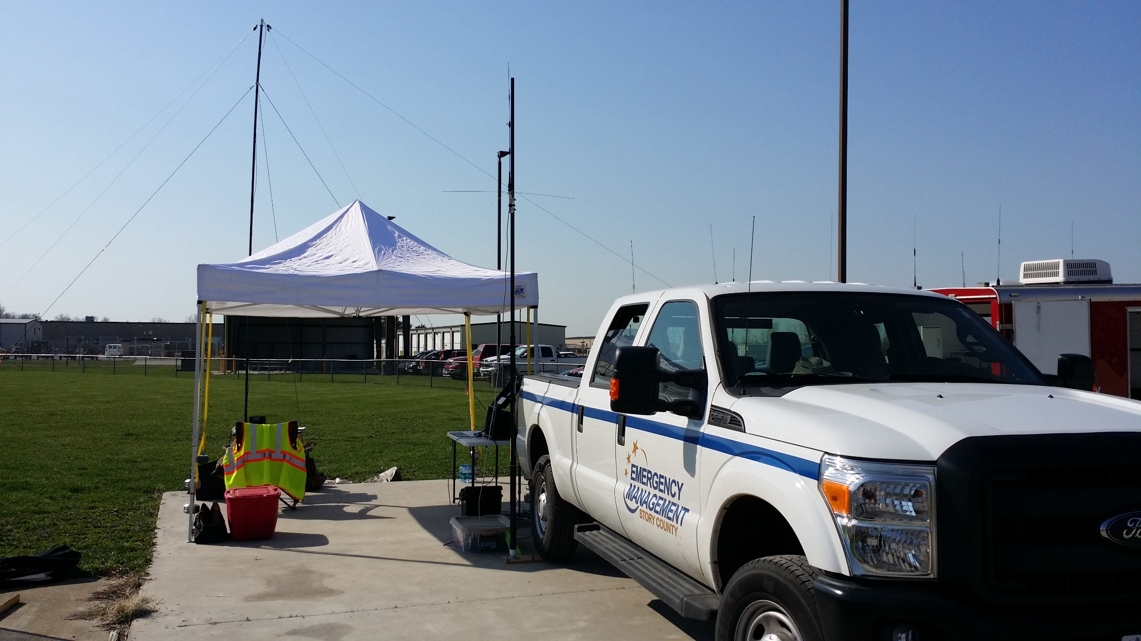

Slide 20
COMMEX #4
October 16, 2015
Camp Dodge, Johnston
Federal, State, and Local Agencies
Polk and Story ARES

Slide 21
COMMEX #4
Objectives
Gain practice for all participating agencies on using their organic equipment to operate on NIFOG interoperability networks
Gain opportunities for agencies to install, operate and maintain cross-banding solutions and mobile repeaters
Experiment with the use of aerial repeaters, HF radio assets, and mobile data for common operating picture and video downlinks

Slide 23
COMMEX #5
April 1, 2016
Polk, Story, and Warren ARES
Multiple separated ICPs, mixed teams
COML trainee opportunities
Story ARES conducted a communications test with Nevada EOC to pass data, repeater checks

Slide 26
COMMEX #6
September 7 & 8, 2017
Polk and Story ARES
Multiple separated ICPs, mixed teams
Training range, 2 full days
60 meters interoperability testing with IA and MO National Guard, MARS

Slide 27
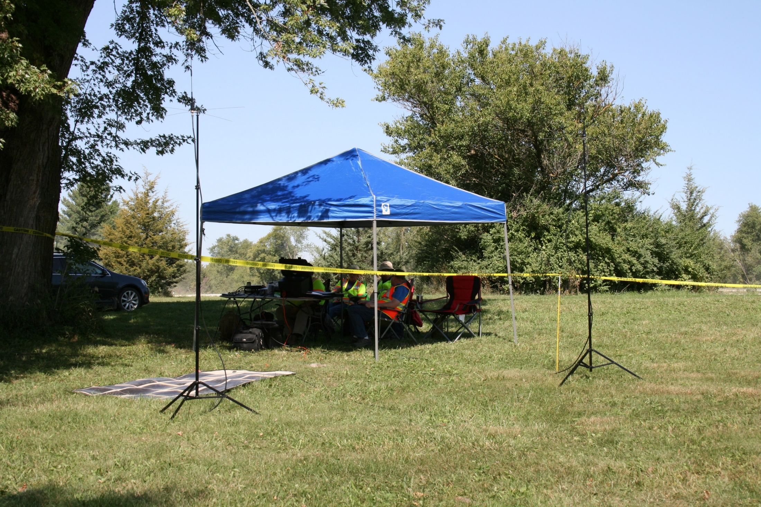

Slide 28
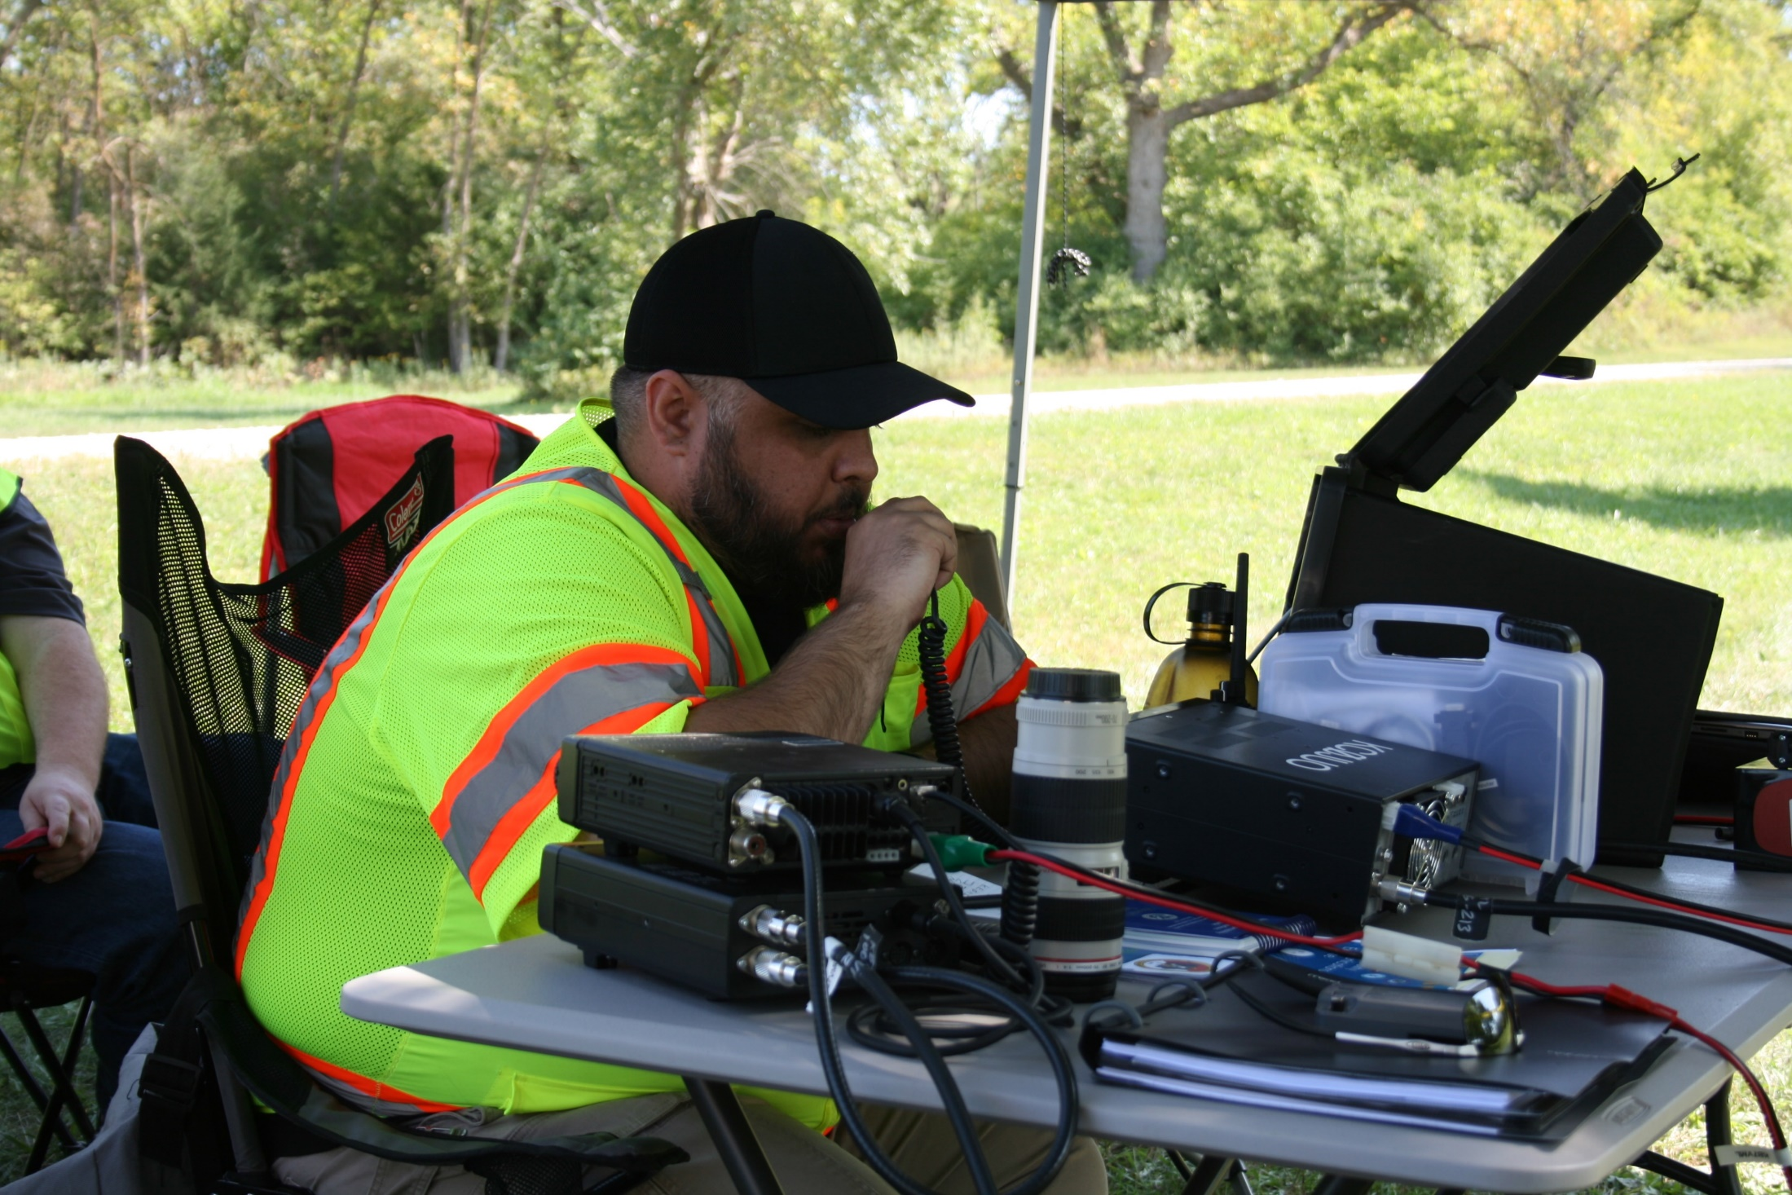

Slide 29
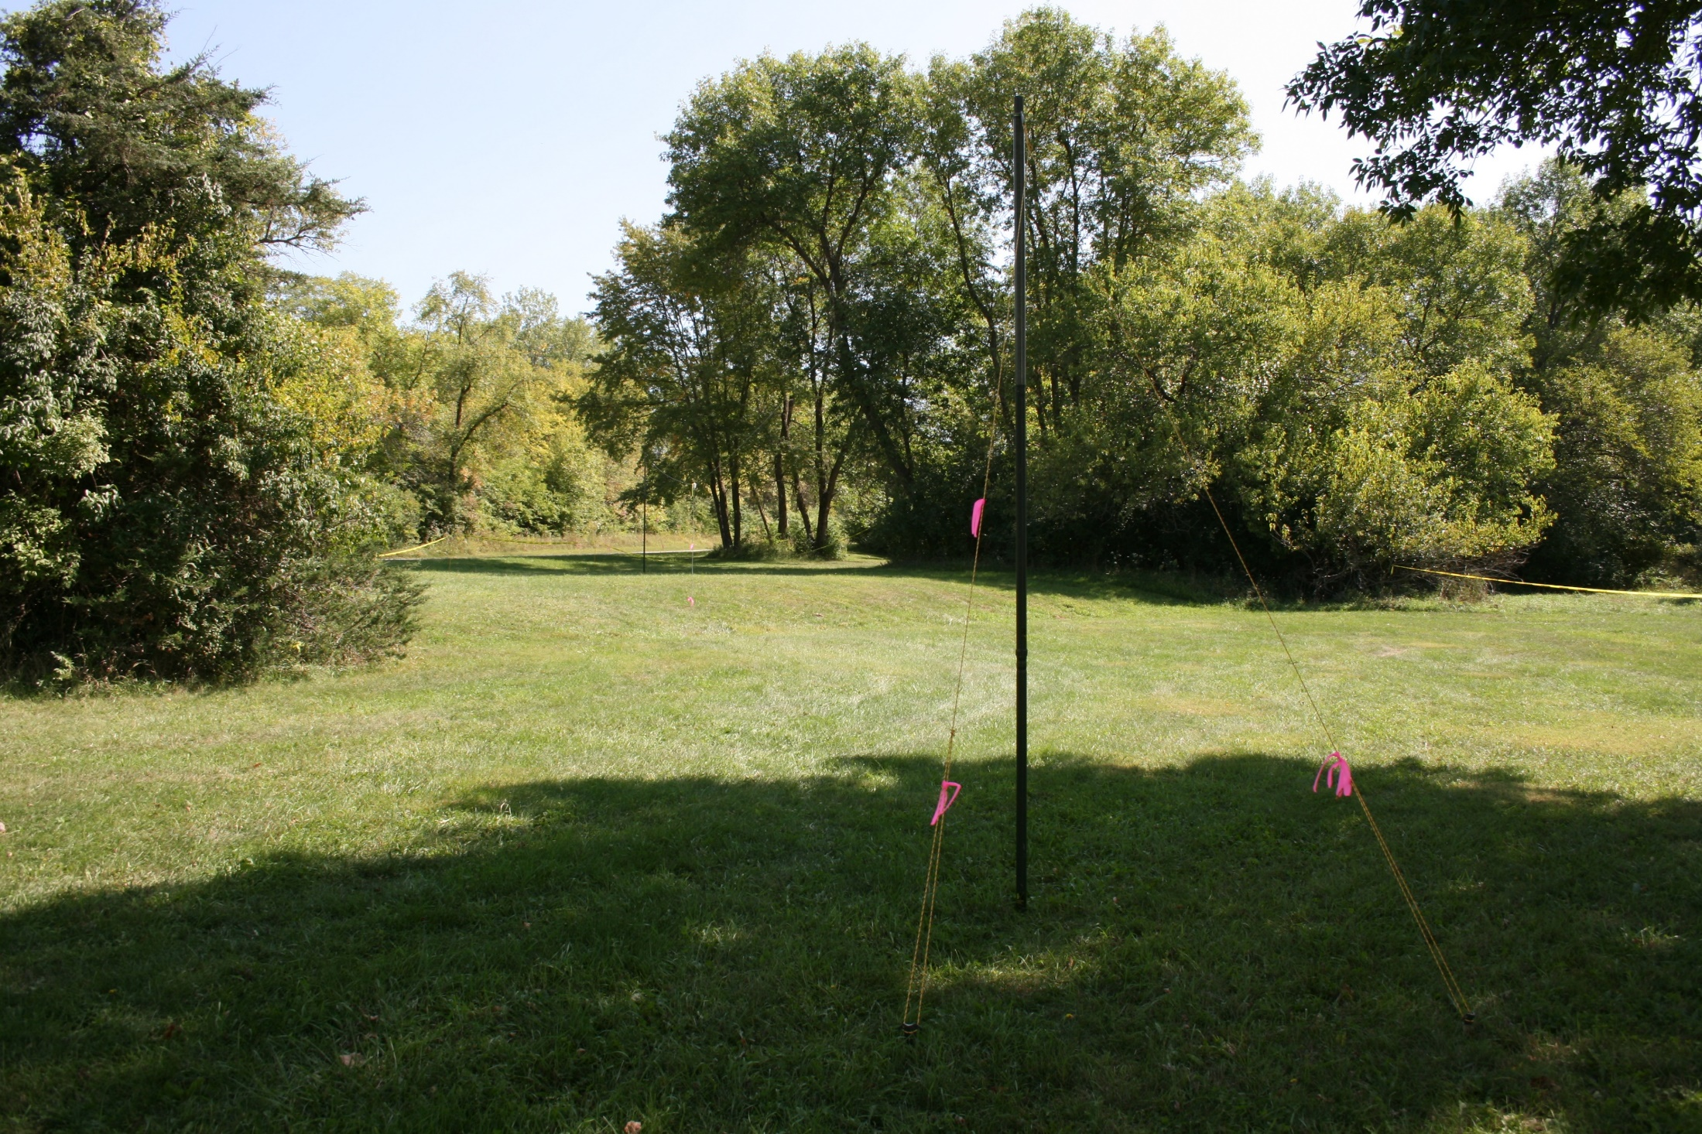

Slide 30
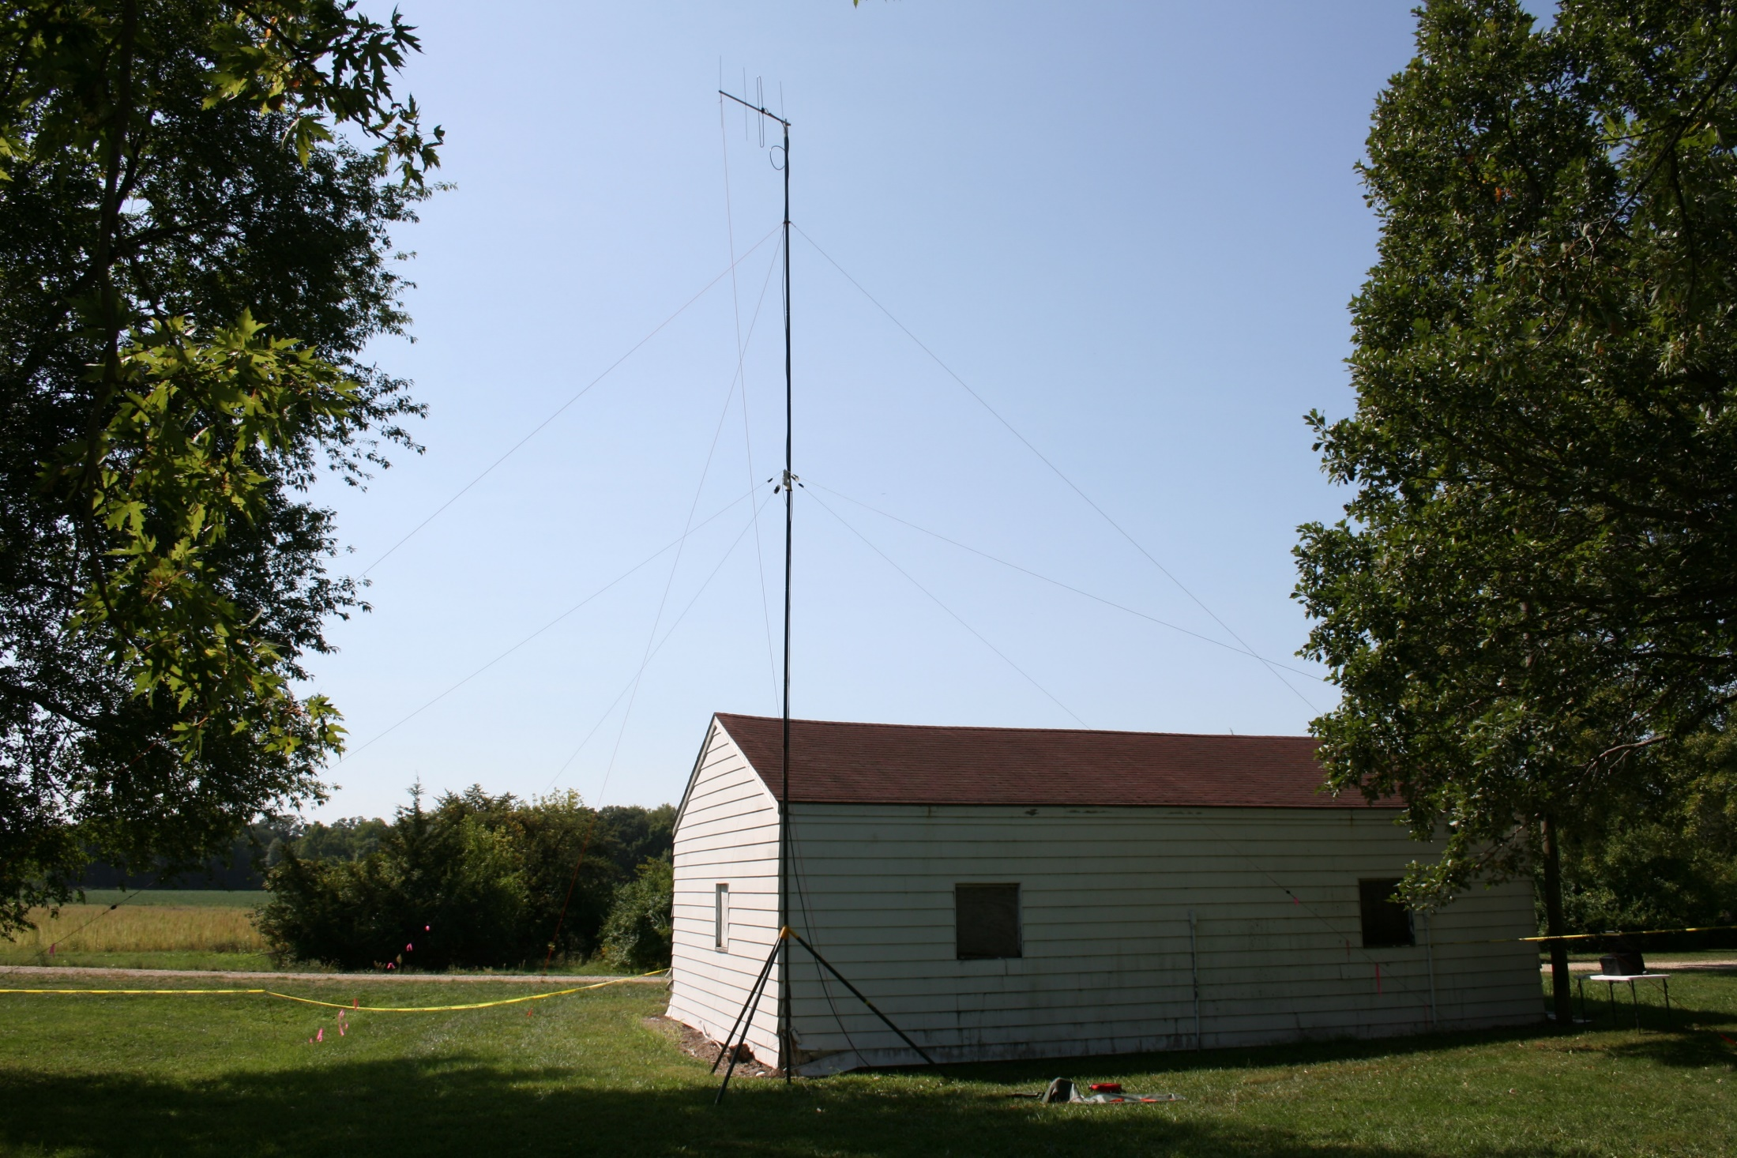

Slide 33
What Exactly is This NVIS Stuff?
Propagation path, NOT an antenna type or mode of communication
“Fills in” distance between ground wave and first hop for low-angle DX communications
Typically covers the range between 50 miles and 600 miles; relatively free from fading
Works best with low antenna height
1/8 wavelength or less
Lower antennas = less received noise!

Slide 34
What Exactly is This NVIS Stuff?
Does not require high power levels
25 Watts is usually sufficient due to shorter paths and reduced D-Layer attenuation
Utilizes any frequency below Critical Frequency (foF2) but above D-Layer attenuation/absorption frequency (LUF)
NVIS is not possible below LUF or above foF2
Generally needs frequencies in the range of 80/60/40 meters depending upon time of day

Slide 35
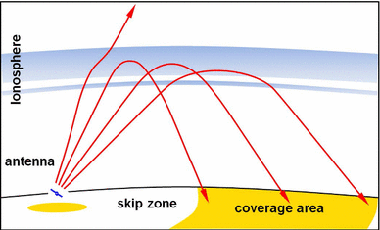
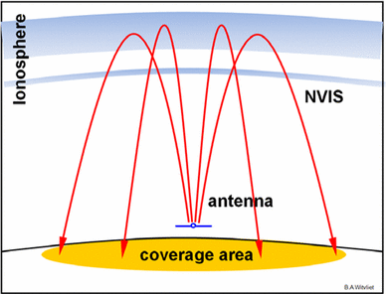
NVIS vs Lower-angle (DX) Propagation
“Traditional” low-angle Propagation – works well for DX communications
NVIS provides reliable regional communications at the expense of DX

Slide 36
5 MHz (60 m) Interop Channels
DHS, FEMA, USCG, MARS, other select Fed entities have primary frequency authorizations
Amateur radio service has secondary authorization on these channels

Slide 37
5 MHz (60 m) Interop Channels
 | SSB (Upper) Dial Frequency | CW / PSK Dial Frequency
Channel 1 | 5330.5 kHz | 5332.0 kHz
Channel 2 | 5346.5 kHz | 5348.0 kHz
Channel 3 | 5357.0 kHz | 5358.5 kHz
Channel 4 | 5371.5 kHz | 5373.0 kHz
Channel 5 | 5403.5 kHz | 5405.0 kHz

Slide 38
5 MHz (60 m) Interop Channels
Government stations use their government issued call sign
Amateurs use their FCC call sign
Amateur stations authorized 100w
Government stations authorized 3Kw

Slide 39
New Developments This Week
MS-DMT
MIL-STD Data Modem Terminal
MIL-STD-188-110A
PSK, serial data mode
Serial tone waveforms use 1200 (S4529) or 2400 baud symbol rates
NOT compatible with amateur 300 baud limit below 28 MHz (60 m excluded)
STA (Special Temporary Authority)
Signal Rate Waiver

Slide 40
Digital vs. Data
Digital modes could mean voice or data
DSTAR, DMR, Fusion, P25
PSK, RTTY, FT8, Packet, APRS
Using “data modes” clears up any confusion

Slide 41
Equipment for
Data Messaging
Radio to receive and transmit
Just about any radio will due for testing and practice
Watch duty cycles and battery life
Data jacks to allow easier interfacing
Interface from radio to computer
TNC
SignaLink USB
Rigblaster
Homebrew interface
Keying circuit or VOX
Acoustical coupling

Slide 42
Equipment for
Data Messaging
Computer to decode and display messages
PC or laptop
Linux or Android single board computer
Tablet or phone
Software to compose and decode messages
Printer
Scanner

Slide 43
ARES Software Standards?
There are NO national or Iowa data messaging and software standards
Local ARES groups can decide which modes, bands, or software fits their needs
Some groups have chosen:
Winlink
NBEMS
Packet
Most groups have
No official system
Don’t offer data messaging

Slide 44
Western Pennsylvania ARES
Using Narrow Band Emergency Messaging System (NBEMS) extensively
Published standards online
Great template to design our own local standards for data messaging
Included standards
Modes
File verification
Transmission of binary files
Formal VHF/UHF and HF net procedures
wpaares.org/html/nbems.html

Slide 45
Narrow Band Emergency Messaging System
Consists of multiple programs:
Fldigi – Fast Light Digital modem application
Flwrap – embed a checksum in a file
Flmsg – easily send ICS forms and Radiograms
Flarq – automatic repeat requests (ARQ)
Can download from www.w1hkj.com
Runs on Windows (XP or newer), Linux, Mac
Android using AndFlmsg app
Open Source, released under GNU Public License, it is completely FREE

Slide 46
Western Pennsylvania ARES
Standard Modes
VHF/UHF FM
MT63-2000 long
HF Keyboard Chat
Olivia 8/500 - good conditions
Olivia 16/500 - bad conditions
HF Bulletins and Forms
MT63-1000 - good conditions
MT63-500 - bad conditions

Slide 47
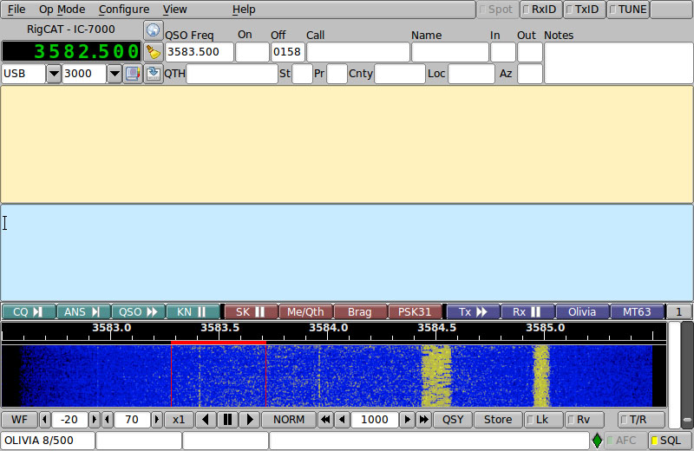
Fldigi

Slide 48
How it works
Fldigi uses your computer's sound card to generate and decode data signals
SignaLink adds separate sound card and VOX
All work is done by your computer, no external Terminal Node Controller (TNC)
Audio from your computer speakers go into your radio's mic input for transmission
Audio from your radio goes into your computer's mic or line-in for decoding
Don't need an extremely powerful new computer, older machines work just fine

Slide 49
Flmsg – Send/Receive Messages
Flmsg is a powerful tool in NBEMS
Can send and receive files very easily with 100% verification
Starts transmission automatically
Can have incoming messages automatically opened
Eases importing and checksum verification of incoming message

Slide 50
Flmsg – Send ICS-213 and ARRL Radiogram
Can send ARRL Radiograms
ICS, Hospital, and Red Cross forms
ICS forms include (not complete list):
ICS-203 Organization Assignment List
ICS-205 Incident Radio Communications Plan
ICS-213 General Message (most common)
ICS-214 Unit Log
Easy workflow for CSV spreadsheets

Slide 51
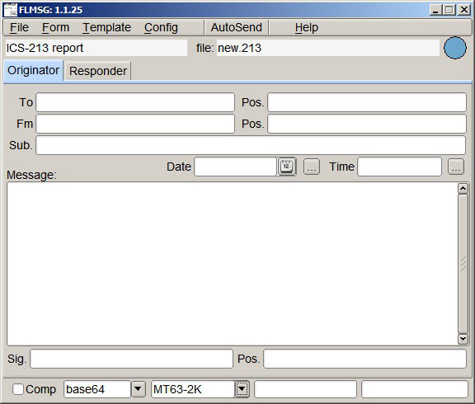
Flmsg Screenshot

Slide 52
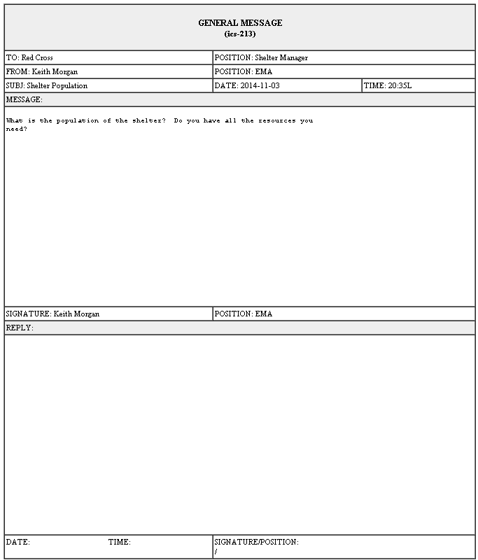
ICS-213 in HTML

Slide 53
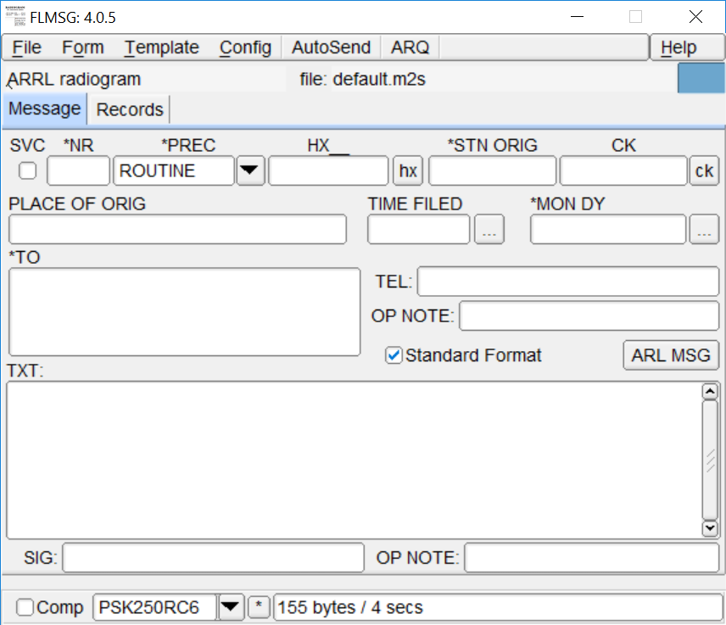
Flmsg Screenshot

Slide 54
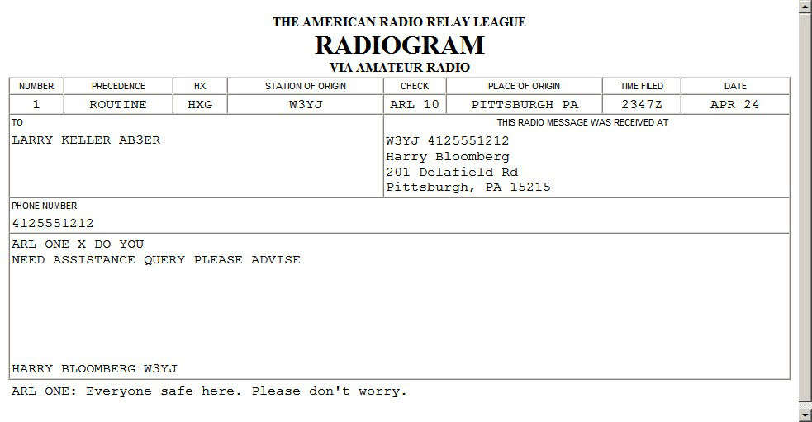
Flmsg – Radiogram HTML Format

Slide 55
Flmsg Custom Templates
Say you need a standard report for...
Hospital bed count
Shelter info
Resource request
Situation report (sitrep)
Flmsg supports custom templates
Distribute before event, or even over the air
Import template into Flmsg, fill it out and transmit
Windows: User > NBEMS files > CUSTOM
Use Template menu to save and load

Slide 56
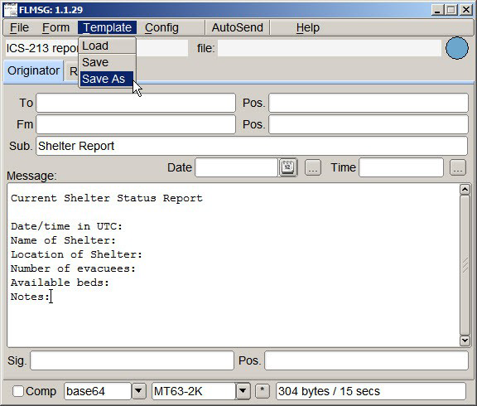
Flmsg Templates

Slide 57
Story EMA Sitrep Template
Started with standard Situation Report format from Story County EMA
KCØEDE converted to an HTML document
Without formatting, text file is much smaller
Smaller means faster
Distribute before event or disaster
Possible to send over air if necessary
http://storyares.org/downloads
Story County EMA SITREP for NBEMS – DRAFT

Slide 59
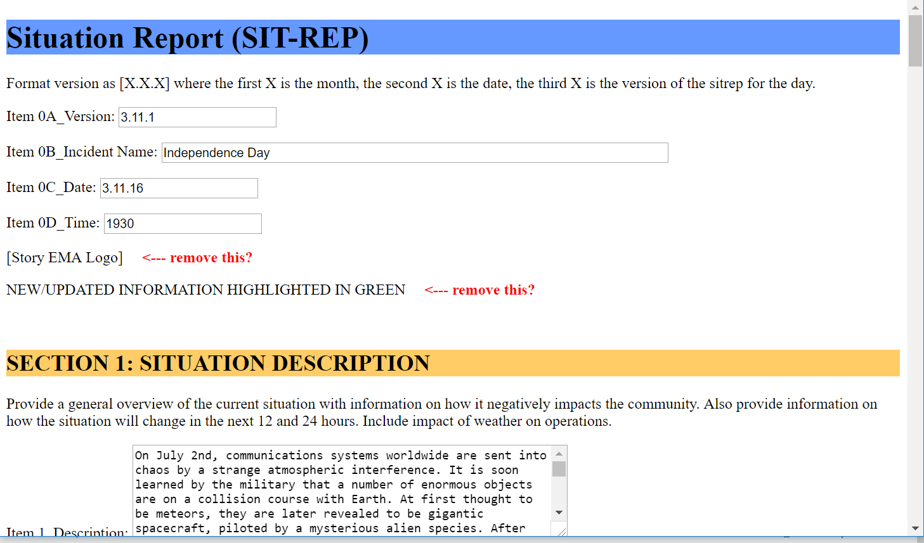

Slide 60
Data Guidelines for NBEMS
Send only text files, no binary files
Do not send Word Documents, save as text
Excel spreadsheets must be exported as CSV
Do not send images
Limit file size to avoid repeater timeouts
CRITICAL: Meet with Served Agency beforehand to set expectations
Encourage Served Agency to give us data electronically
Remember, we have limited bandwidth

Slide 61
Resources
W1HJK (author of Fldigi) http://www.w1hkj.com/
QST Articles
April 2008
August 2009
September 2013
ARRL NBEMS page http://www.arrl.org/nbems

Slide 62
Final Thoughts on Data
Learn HF modes (especially Winlink) if you have national deployment aspirations
Building our response capabilities around NBEMS on VHF/UHF
We plan to develop and publish standards and Quick Start Guides for Setup and Use
Use WPA ARES standards for now
Until standards are defined, experiment until you find what works
Data modes with no automatic error correction should only be used when clean and interference-free signals can be guaranteed

